Slide 1

Geneticheck
UofTHacks 2022 – Atilla Saadat

Slide 2



Geneticheck
Geneticheck is a smart software that allows a patient or parents of patients with rare diseases to gather more information about their specific conditions and genetic mutations.

Slide 3
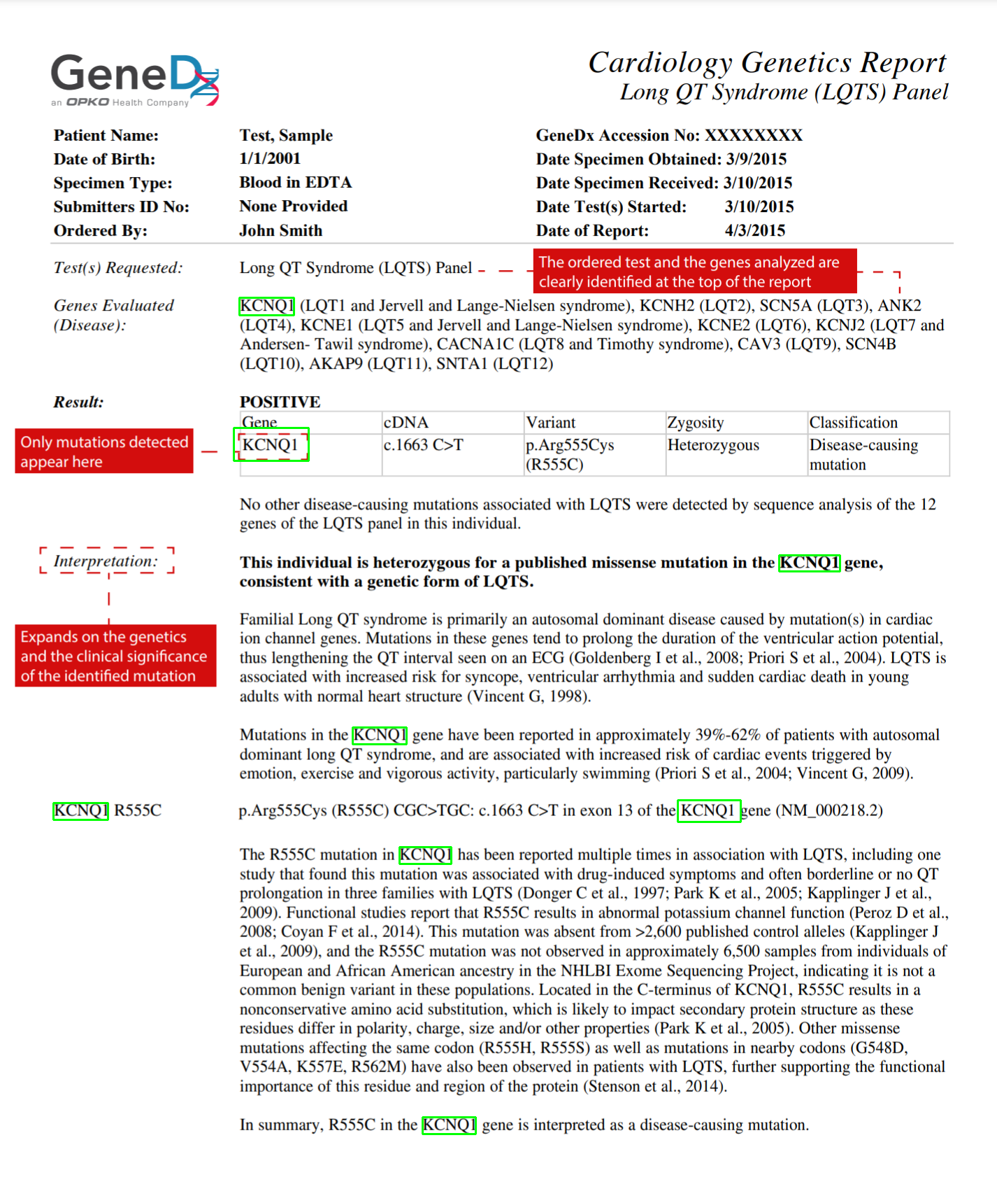
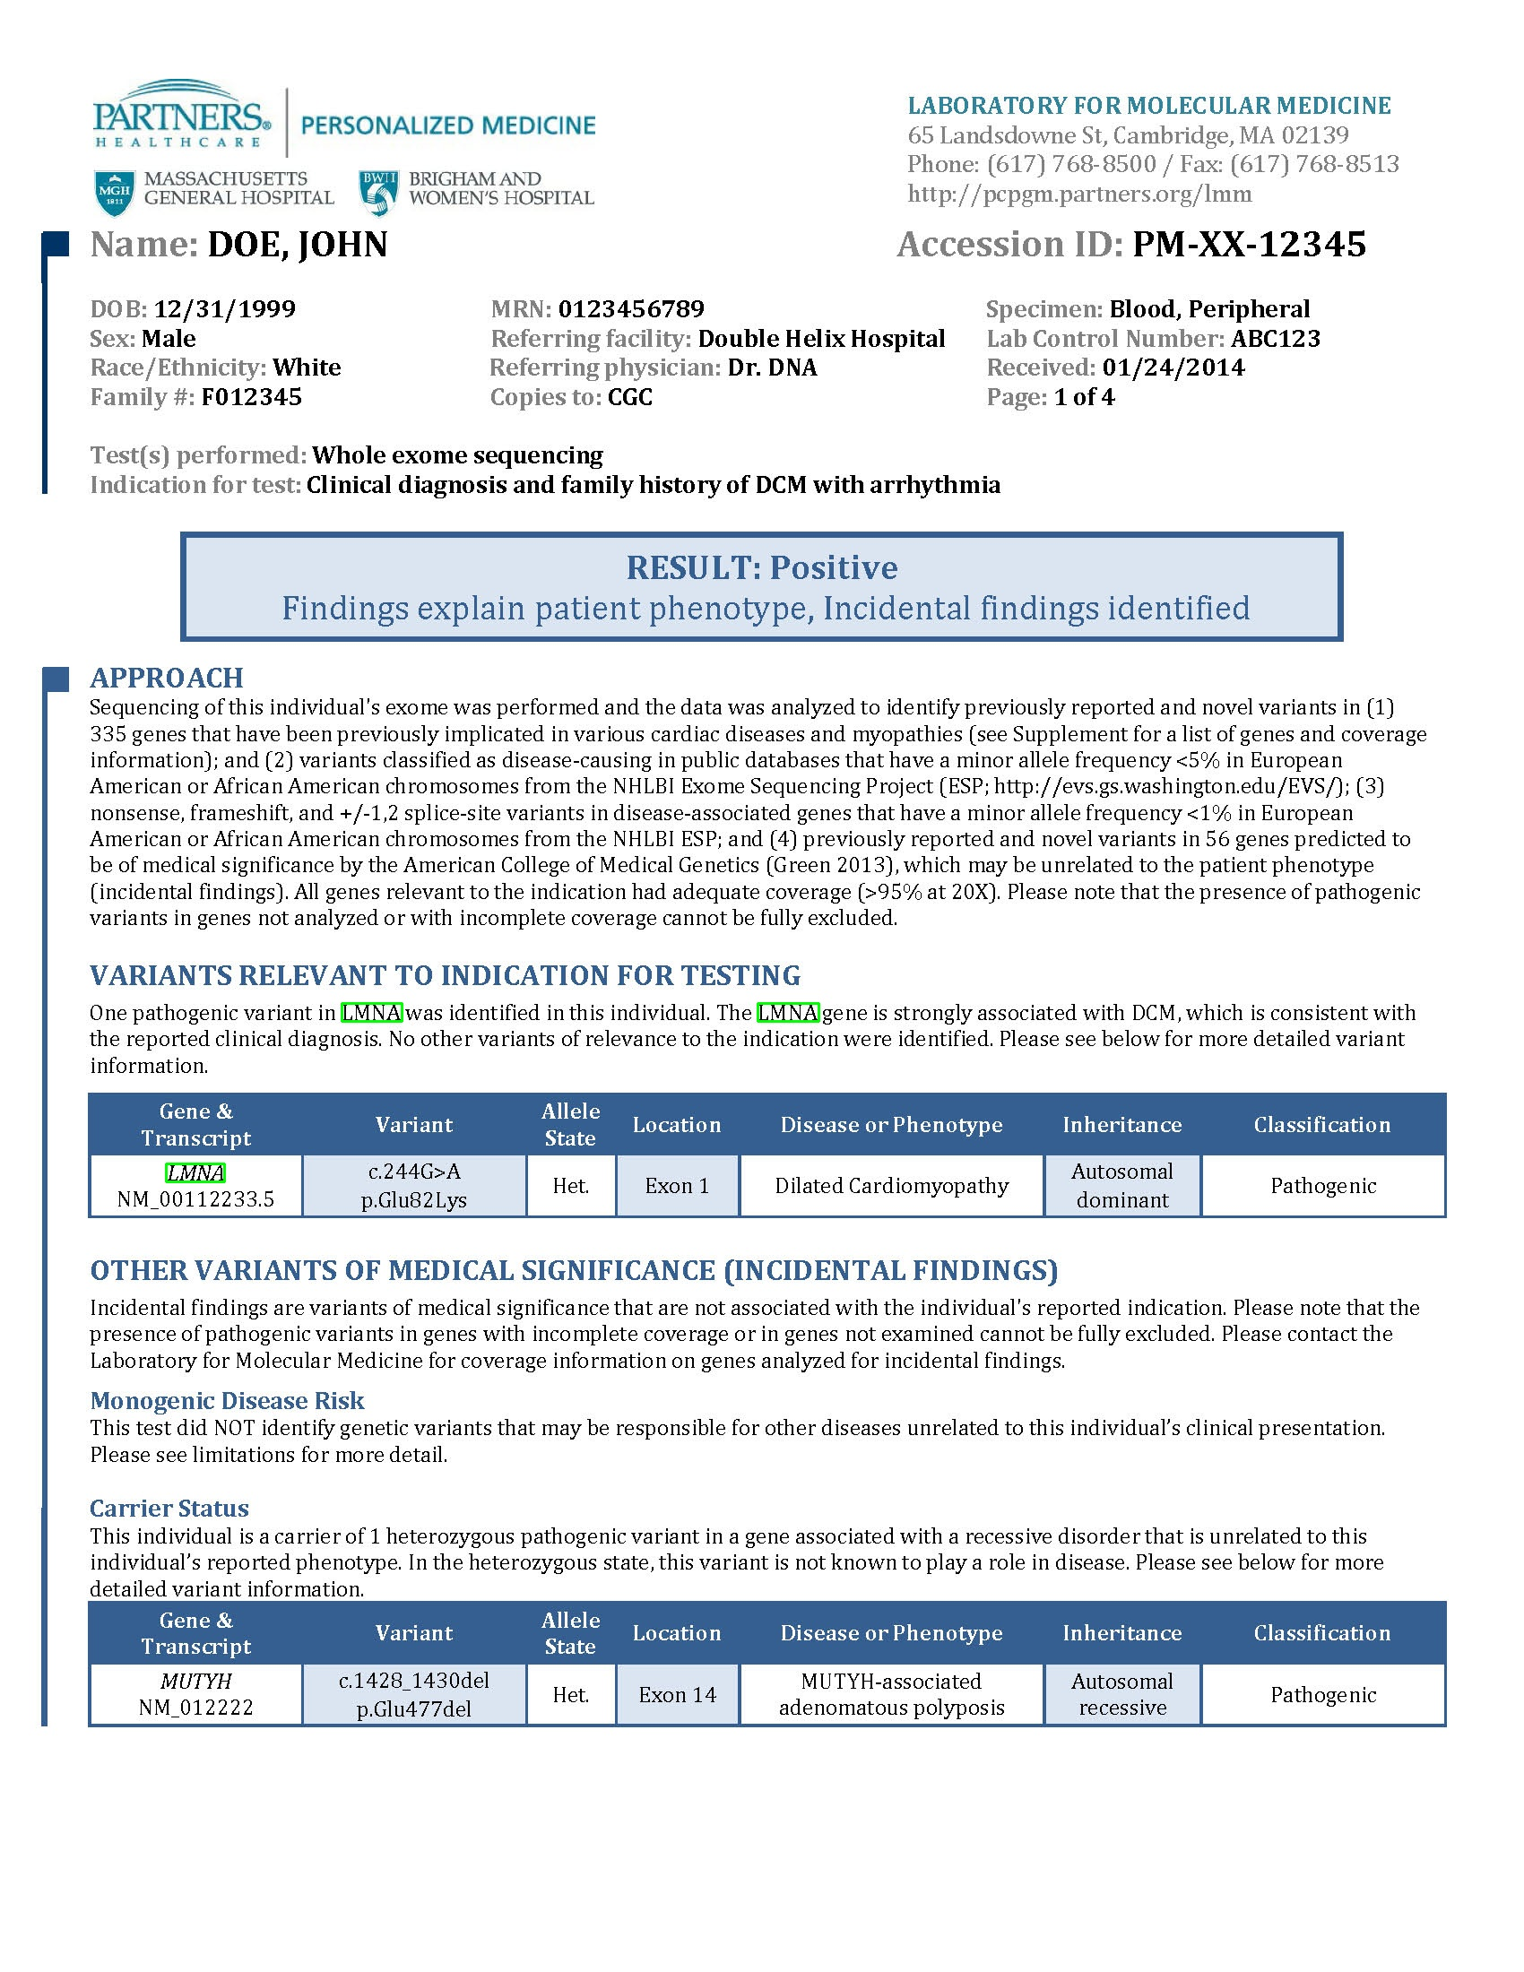
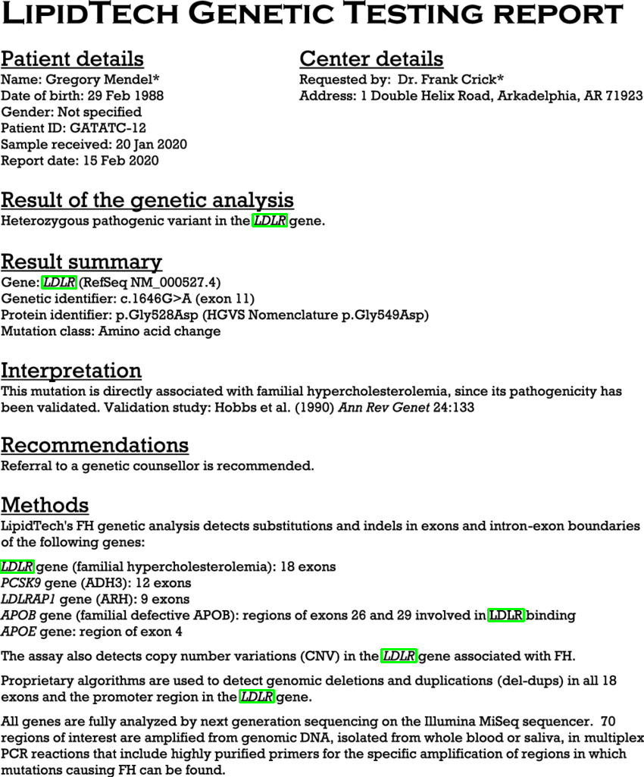

Slide 4
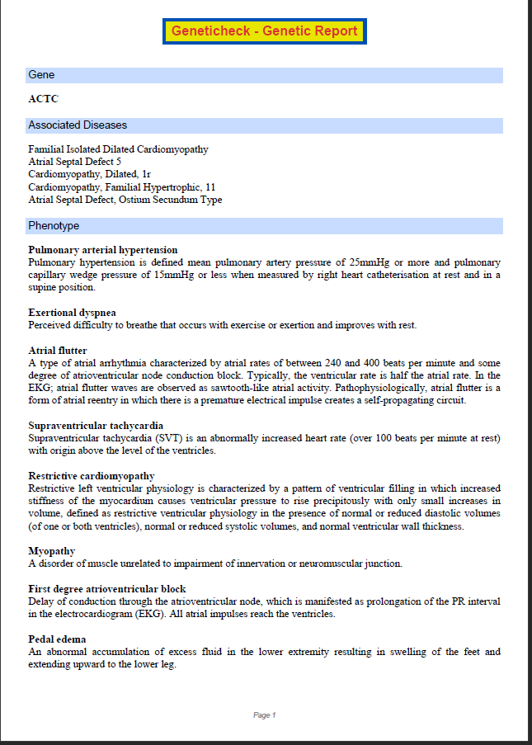

Slide 5
Additional content
Currently, Geneticheck is a python-based command line tool
Future iterations plan to port the algorithms and methods to a web-based interface for a better User experience.

Slide 6

Thank you
Atilla Saadat
atilla.saadat@mail.utoronto.ca
https://atillasaadat.me

